Slide 1
Microsoft Teams Developer
Tabs and Connectors

Slide 2

Tabs
Static Tabs
Tab Content and Configuration
DEMO

Slide 3
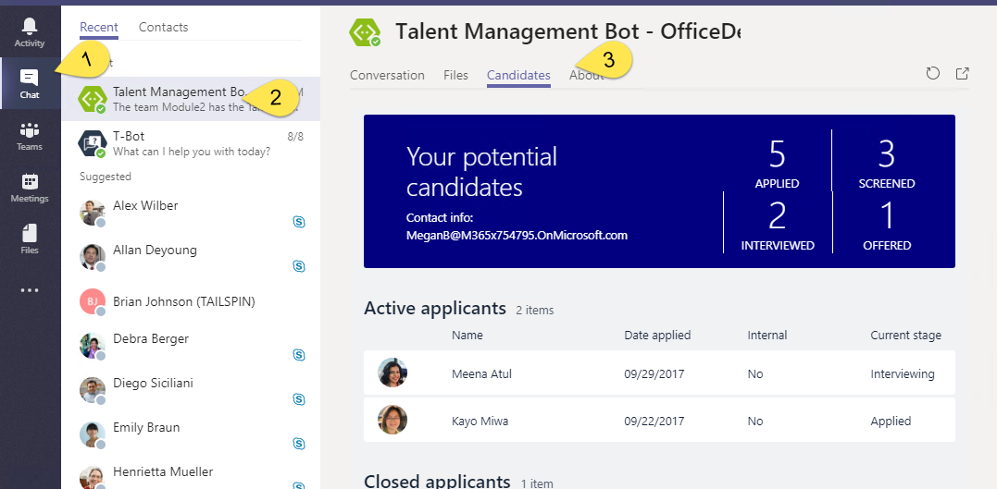
Static Tabs
A content page declared directly in manifest
No Configuration
Added in “personal” scope
Accessed via the app bor or alongside bot conversation

Slide 4
Static Tabs - Manifest
"staticTabs": [ { "entityId": "candidatesTab", "name": "Candidates", "contentUrl": "https://.../Tabs/candidates.html", "websiteUrl": "https://.../Tabs/candidates.html?web=1", "scopes": [ "personal" ] } ],
"validDomains": [ "token.botframework.com" ]
staticTabs node
contentUrl is hosted in IFRAME in Teams
websiteUrl is used as target for link
validDomains node
A list of valid domains from which the extension expects to load any content.

Slide 5
Tab Configuration and Content
Tab Configuration
Configured in manifest
Displayed when Tab added to Channel
Collect information
Call setSettings() specifying Content Url and Entity Id
Tab Content
Rendered in IFRAME
Url specified by configuration page
Inspect context for EntityId/SubEntityId
Retrieve state based on Entity/SubEntity/User
Notes:
To provide a seamless tab experience, perform provisioning and authorization on configuration page when possible.
If context has entity/subentity, then respond to a deeplink
State storage is developer’s responsibility

Slide 6
Demo Add static tabs and valid domains to Teams App

Slide 7

Summary
Static Tabs
Tab Content and Configuration

Slide 8
Thank you

